Slide 1
Review 4 Sample network for an enterprise ,by installing network-based firewall
2010030151 K S Satyavarsan
2010030071 Jyothin Movva
2010030040 Devaraj Acharya
Guide
Dr. P Lalitha Surya Kumari

Slide 2
ABSTRACT
In this project we are going to design a network for an enterprise with firewall
We will be using different topologies and various other things we studied in this course to design this network
Firewall is used for network security and its job is to monitor and filter incoming and outgoing network traffic in order to keep the network safe from any vulnerabilities or threats

Slide 3
OBJECTIVE OF NETWORK
Secure Service: The main objective of this network is to provide secure administrative computing service to an enterprise.
Versatile Information Processing: The network will enable users to retrieve, process, and store ASCII and non-ASCII text, still graphics, audio, and video from any connected computer.
Collaboration: The network will combine the power and capabilities of diverse equipment across the enterprise to provide a collaborative medium that helps users combine their skills regardless of their physical location. A network for this enterprise will enable people to share information and ideas easily so they can work more efficiently and productively.

Slide 4
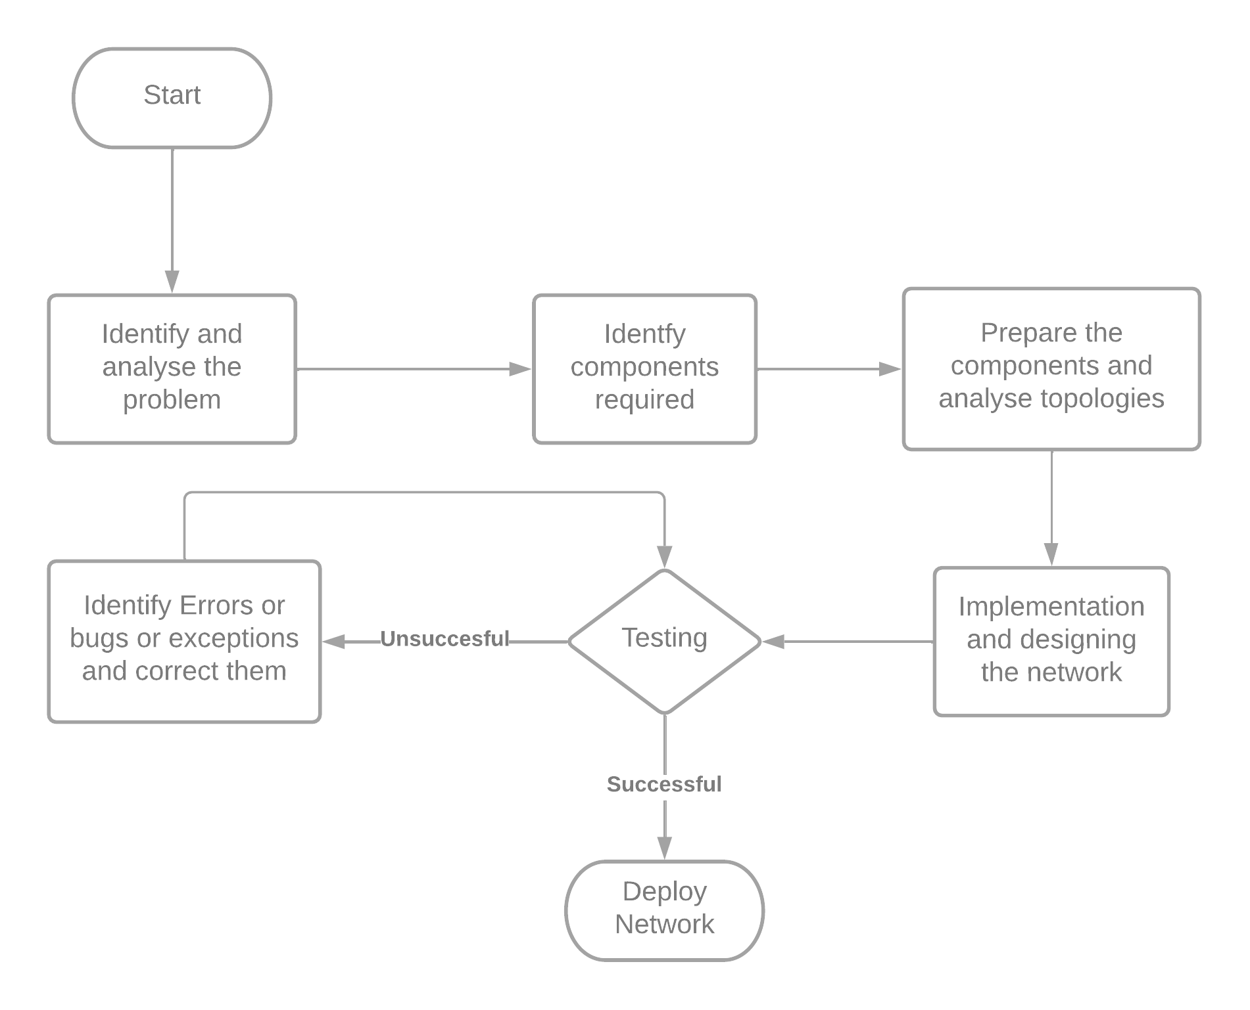
IMPLEMENTATION FLOWCHART

Slide 5
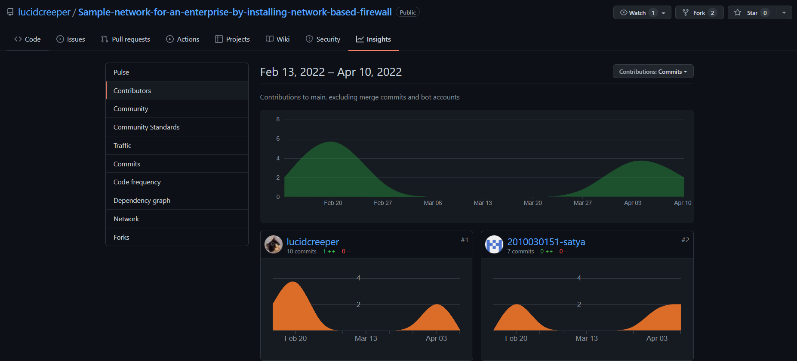
GITHUB COMMITS

Slide 6
WORK PROGRESS
Will implement a institution network with multiple subnets interconnected with each other.
DNS implemented
Made a website for an enterprise which can be accessed from all nodes

Slide 7
METHODS
Software required:
windows 10 or later
Cisco Packet Tracer
Hardware to support the software requirements.

Slide 8
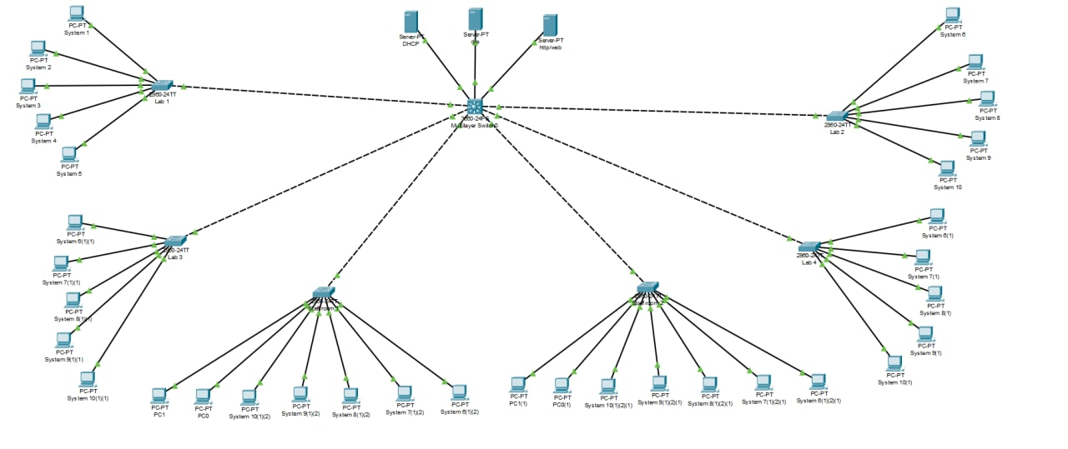
BETA TESTING

Slide 9
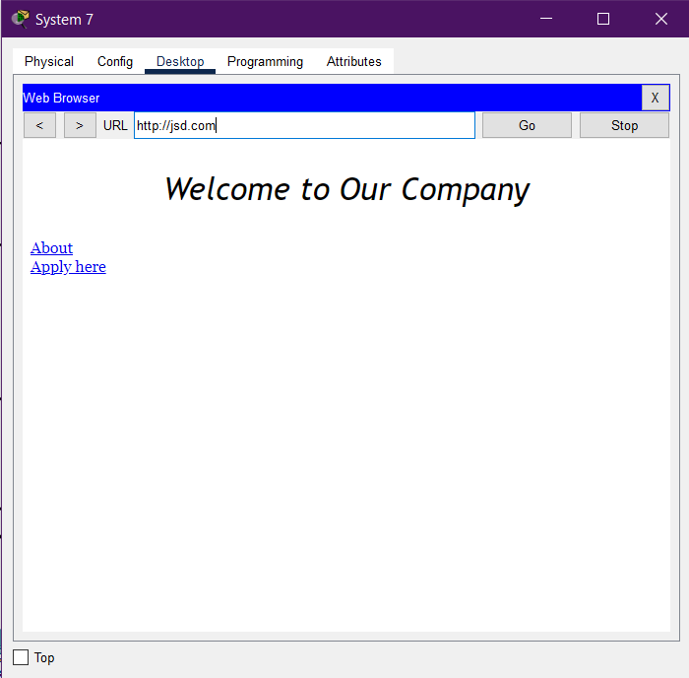
BETA TESTING

Slide 10
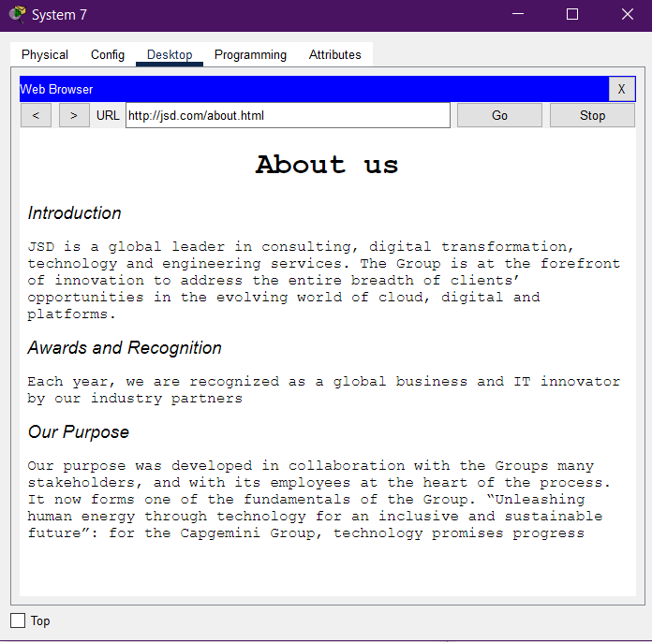
BETA TESTING

Slide 11
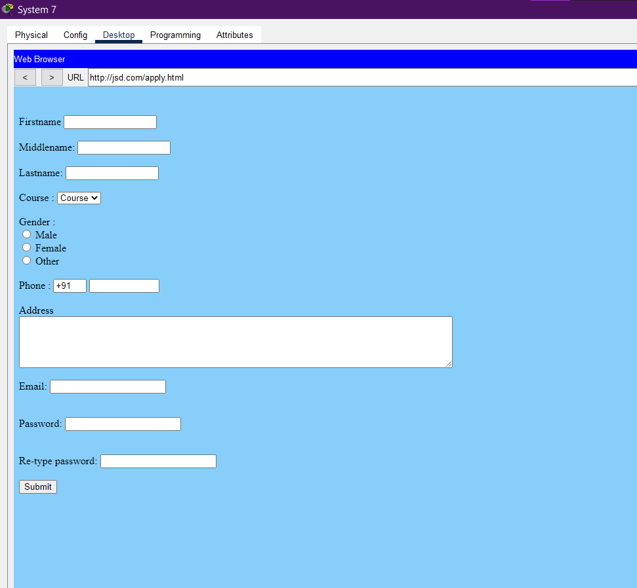
BETA TESTING

Slide 12
SUGGESTIONS

Slide 13
THANK YOU

